Slide 1

WIPRO NGA Program – DWS
Capstone Project Presentation – 17th June & 18th June 2025
Project Title - Customize MSIX App Launch Behavior - Modify the AppxManifest.xml to control app behavior and appearance.
Presented by – 28953 – Kranti Jadhav
www.rpsconsulting.in

Slide 2

Introduction
This project helps us understand how to modify an MSIX app’s behavior during launch using the AppxManifest.xml file
The AppxManifest.xml file within the MSIX package defines the app's launch behavior, appearance, and settings.
It includes details like the app name, icon, description, background color, entry point, and other settings
2024 - RPS Consulting all rights reserved

Slide 3
Objectives
Modify the AppxManifest.xml file within an MSIX package to control how the application behaves and appears during launch.
This includes:
Customizing the Display Name of the app
Editing the Description to better reflect app functionality
Changing the App Icon and Background Color to align with branding
2024 - RPS Consulting all rights reserved

Slide 4
Prerequisites
Installed MSIX Packaging Tool
A working .msix package
Valid .pfx certificate
PowerShell installed
Text editor (Notepad++, VS Code)
Basic understanding of XML structure
2024 - RPS Consulting all rights reserved

Slide 5



Introduction-to-Tools
MSIX Packaging Tool
PowerShell
Notepad++
2024 - RPS Consulting all rights reserved

Slide 6
Flow chart
Create/Open MSIX Package
Rename .msix → .zip
Edit APPXManifest.xml File
Re-zip Contents →
Rename back to .msix
Digitally Sign using MSIX Packaging Tool
2024 - RPS Consulting all rights reserved

Slide 7
To Get Started With This Project
1. Rename the .msix file to .zip
2. Extract the zip to view internal contents
3. Locate AppxManifest.xml file
4. Open it using Notepad++ or Visual Studio Code
5. Make changes to:
DisplayName
Description
6. Save the file
2024 - RPS Consulting all rights reserved

Slide 8
Usage Process
Make edits in XML
Repack contents into .zip
Rename to .msix
Use PowerShell or MSIX Tool to sign
2024 - RPS Consulting all rights reserved

Slide 9
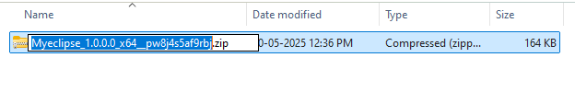
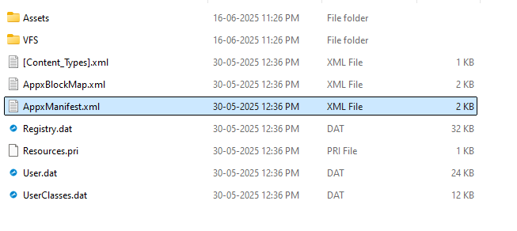
Execution Overview
1. Rename your .msix file to .zip Right-click and Extract All to see all its internal files.
2. Open AppxManifest.xml using Notepad++
2024 - RPS Consulting all rights reserved

Slide 10
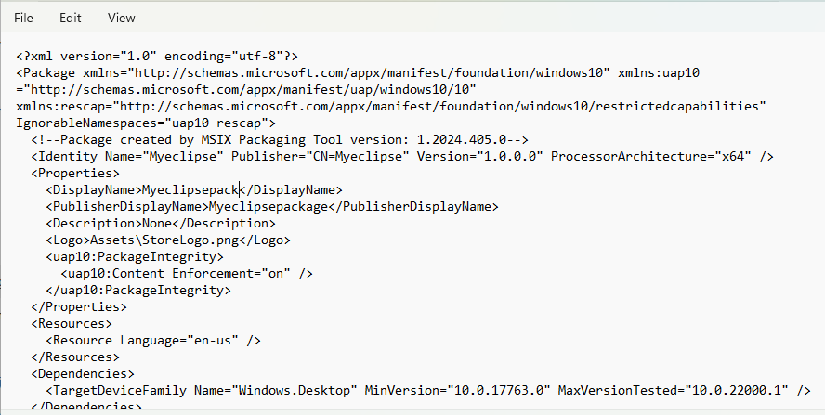

Execution Overview
3. Make Custom Changes in the file
4. Change the DisplayName, Description
2024 - RPS Consulting all rights reserved

Slide 11
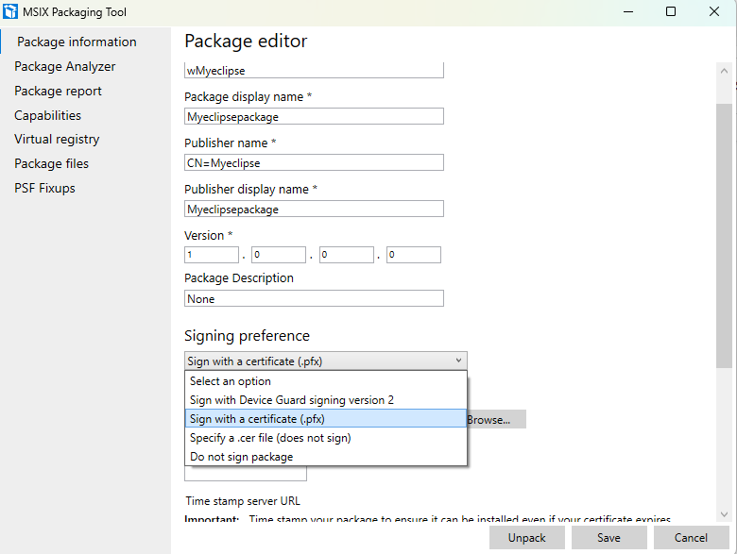

Execution Overview
5. Save the file, Repack contents into .zip Rename to .msix them again
6. Sign the updated .msix file using certificate.
2024 - RPS Consulting all rights reserved

Slide 12
Reference
Advanced Installer
https://www.advancedinstaller.com/application-packaging-training/msix- /ebook/appxmanifest.html
2. Microsoft
https://learn.microsoft.com/en-us/windows/msix/packaging-tool/create-app-package
2024 - RPS Consulting all rights reserved

Slide 13
Thank you
2024 - RPS Consulting all rights reserved

